Slide 1
Homeostasis
Heart rate and blood pressure

Slide 2
Cardiac output
Heart rate – the number of times the heart beats in a minute
Stroke volume – the amount of blood leaving the heart with each contraction.
Cardiac output (mL/min) = heart rate x stroke volume

Slide 3
Blood pressure
Blood pressure is the pressure of the circulating blood against the walls of the blood vessels.
Pressure is highest when the ventricles in the heart contract (systole) and lowest when they relax (diastole).
Blood pressure is recorded as two numbers: the top number is called the systolic pressure and the bottom number is called the diastolic pressure.
Adult blood pressure is considered normal at around 120/80.

Slide 4
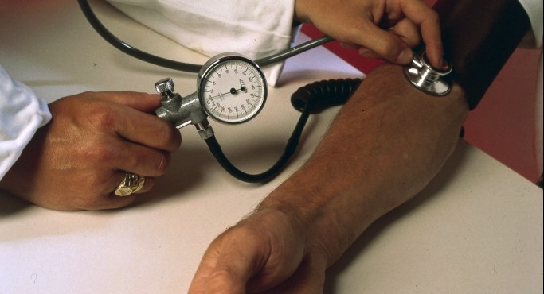
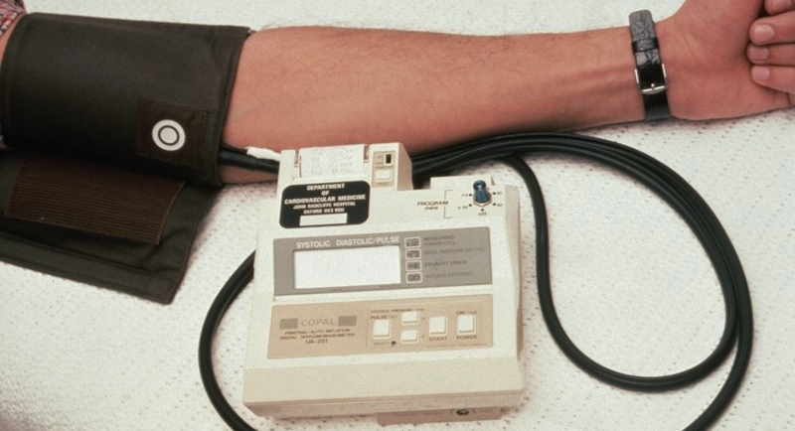
Measuring blood pressure
Blood pressure is measured using a sphygmomanometer.
Values are reported in millimeters of mercury (mmHg)
A traditional analogue sphygmomanometer (left) and an electronic digital sphygmomanometer (right).

Slide 5
Physiological factors affecting blood pressure
Factor | Effect on blood pressure
The pumping action of the heart | The greater the cardiac output, the higher the arterial pressure
The blood volume | The greater the blood volume, the higher the arterial pressure
The viscosity of the blood | The more viscous the blood, the higher the arterial pressure
The condition of the blood vessels (resistance) | The greater the resistance, the higher the arterial pressure

Slide 6
The hearts ‘pacemaker’
The heart contains specialised conductive tissue which regulates the heartbeat.
The sinoatrial node (SA node or ‘pacemaker’) is a cluster of specialised cardiac cells in the wall of the right atrium which initiates the heartbeat.
The atrioventricular node (AV node) is the secondary pacemaker which regulates the beating of the ventricles.

Slide 7
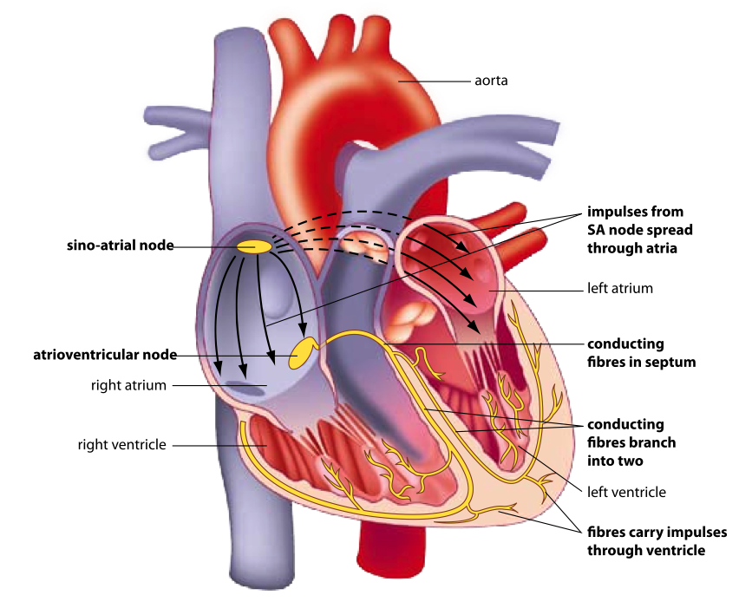
The hearts ‘pacemaker’
Without intervention the heart would continue to beat a constant rate as determined by the SA node.

Slide 8
Receptors
Pressoreceptors (baroreceptors) – respond to changes in blood pressure.
They are found in the aorta, right carotid artery and the right atrium.

Slide 9
The cardiac centre
A region of the medulla oblongata. Connected to the Sinoatrial node and the atrioventricular node via neurons of the sympathetic (increase heart rate and stroke volume) and parasympathetic (inhibit – decrease the heart rate and strength of contraction) divisions.
There are also neurons that connect the cardiac centre with the muscles of the walls of blood vessels. This allows the cardiac centre to control vasodilation/vasoconstriction in response to changes in blood pressure.

Slide 10
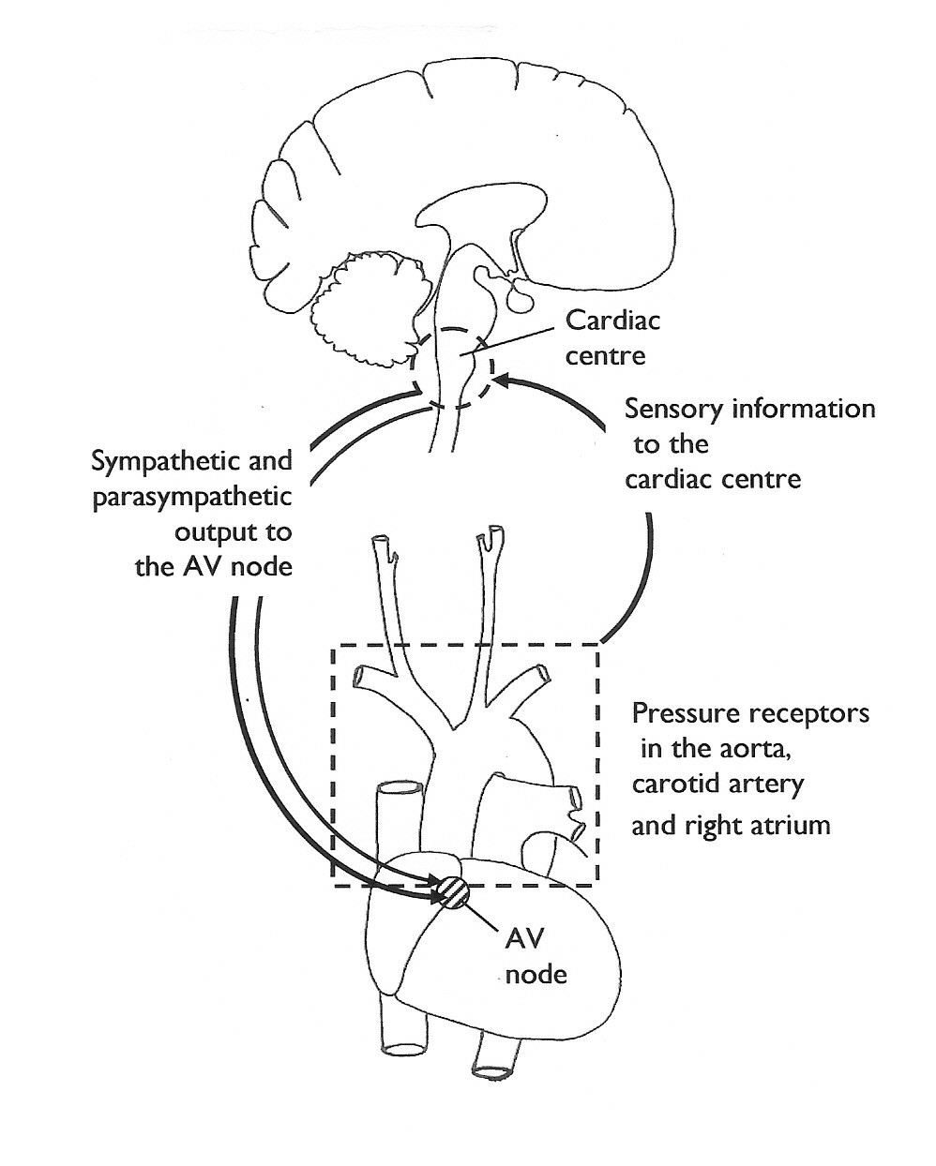
REGULATION OF THE
HEART RATE

Slide 11
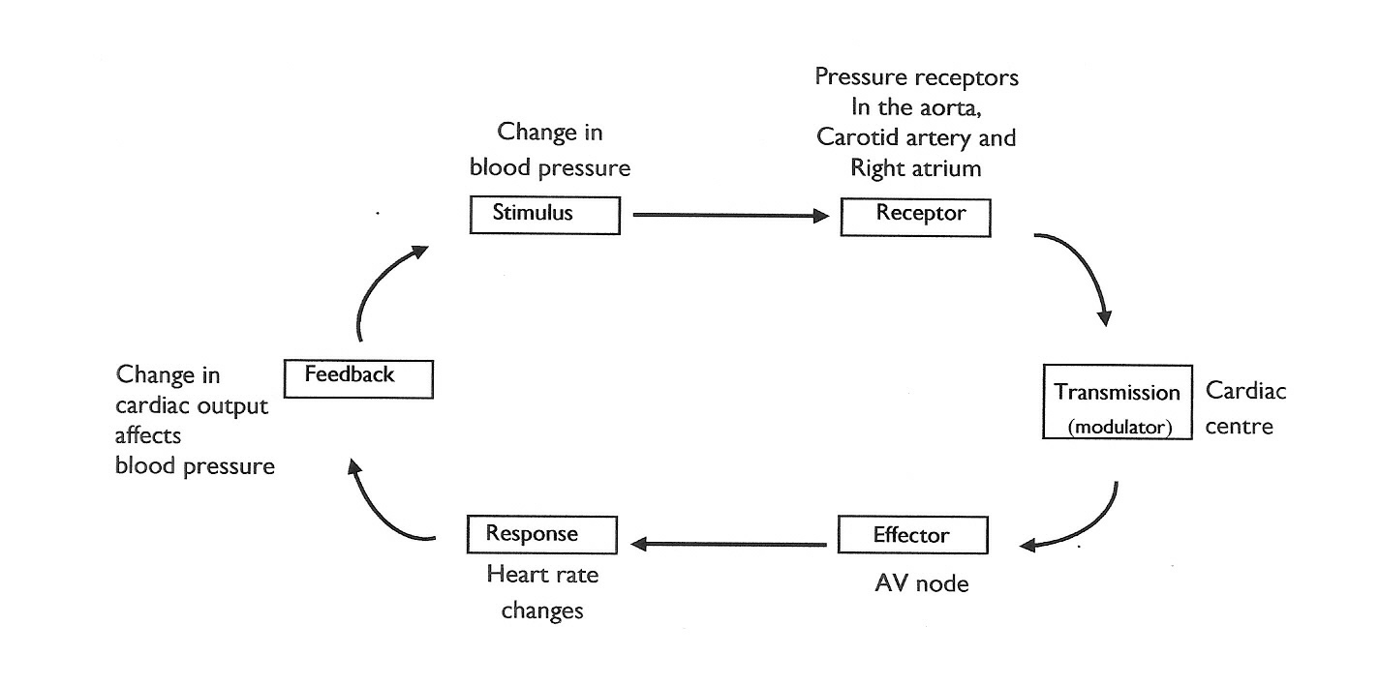
REGULATION OF THE HEART RATE
ANS

Slide 12
Factors influencing stroke volume
Length of diastole (resting period before contraction) – the longer the resting period the more blood can enter the heart and thus more will be pumped.
Venous return (the amount of blood returning to the heart) – the more blood that enters will result in more blood being pumped.
Activity of the sympathetic division – noradrenaline increases the force of cardiac contraction therefore pumping a greater volume of blood.

Slide 13
Other factors affecting heart rate
Age – heart rate is fastest at birth and slows as we get older.
Gender – males tend to have a lower heart beat than females
Emotional state – anger, fear and anxiety cause heart rate to increase. Depression and grief cause heart rate to decrease.

Slide 14
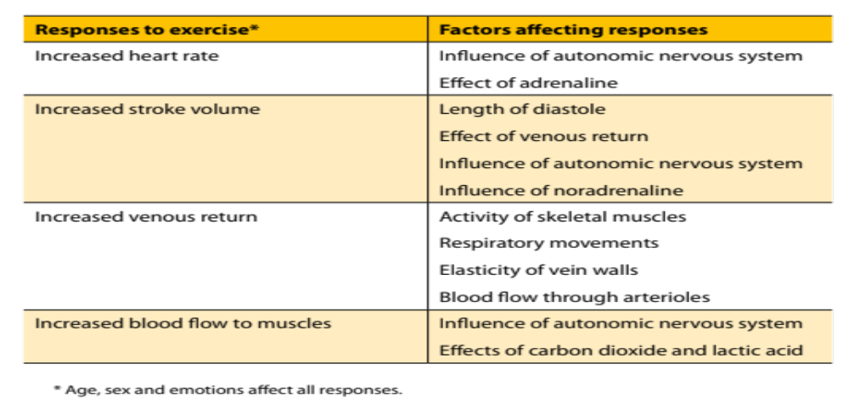
Response to exercise

